Slide 1


SRI RAMAKRISHNA ENGINEERING COLLEGE
[Educational Service : SNR Sons Charitable Trust]
[Autonomous Institution, Accredited by NAAC with ‘A’ Grade]
[Approved by AICTE and Permanently Affiliated to Anna University, Chennai]
[ISO 9001:2015 Certified and all eligible programmes Accredited by NBA]
VATTAMALAIPALAYAM, N.G.G.O. COLONY POST, COIMBATORE – 641 022.
16IT258 MINI PROJECT
PROJECT GUIDE TEAM MEMBERS
Dr.J.Anitha,
Asso.Professor,IT
Department of IT
Yogapriya P (1805161)
Samayanjali M (1805121)
II B.Tech IT-B

Slide 2

DOMAIN
ARTIFICIAL INTELLIGENCE & DEEP LEARNING
PROJECT TITLE
EMOTION ANALYSIS USING SPEECH RECOGNITION

Slide 3
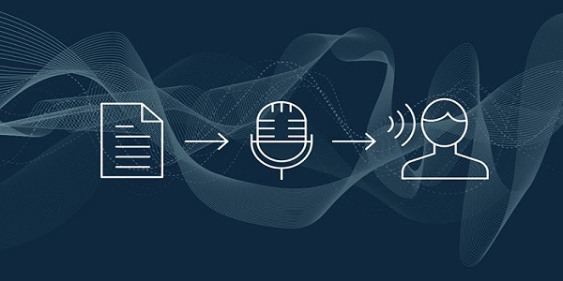
CONTENTS
Introduction
Objectives
Block Diagram
Problem statement
Existing systems
Proposed system
Algorithm
Training
Datasets
Output and Result
References

Slide 4
INTRODUCTION
The basic principle behind emotion recognition lies with analysing the acoustic difference that occurs when uttering the same thing under different emotional situations.
Sound signal is one of the main medium of communication and it can be processed to recognize the speaker, speech or even emotion.
In addition to the features corresponding to the speaker and/or the speech, the sound signals do have some features that represents the emotional state of the speaker.
Speech signals can be analysed to detect heart rate, which will naturally enable a remote diagnosis of a patient by only using audio data

Slide 5
OBJECTIVES
To develop the Human-Machine Interaction system.
To demonstrate a simple and compact Emotion Recognition System using the Acoustic and Language model using Machine Learning.
To analyze the speaker’s emotions like sad ,angry ,neutral , happy and some mixed emotions like anxiety , surprising , etc.,
To apply these implementation in various fields such as Review rating, Psychological treatment, Crime investigations etc.

Slide 6
PROBLEM STATEMENT
The Emotion Recognition System provides a solution in the field of medicine as a result of analysing the patient’s emotion.
The different types of mood analysis can be done using the peak representation of the voice spectrum.
The basic emotions and the mixed emotions can be easily identified.
By analysing the emotion,the psychological treatments can be carried out on its best level.
This can also be implemented in the area of review rating,crime investigations etc.

Slide 7
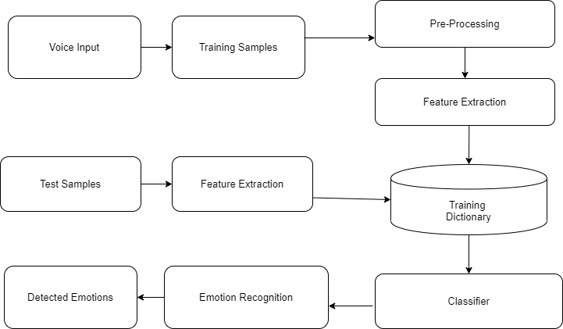
BLOCK DIAGRAM
Algorithm
Fig 1 Diagram representing the process of the model

Slide 8
EXISTING SYSTEMS
Several experiments have been performed before the experiments based on speech transcriptions and speech features independently as well as together in an attempt to achieve accuracies greater than existing methods.
The emotions are recognized not only based on the spectrum obtained from the speech signals but also from other physical and biological sources.
And the other existing systems are,
1. Emotion analysis based on facial expressions
2. Emotion analysis based on motor signals

Slide 9
Emotional Analysis based on facial expressions
The analysis was done using the existing Microsoft Application Programming Interface (API) titled Microsoft HoloLens(MHL).
MHL was made to detect the emotions enacted by the people. As people found it difficult to hold the emotions that were depicted, the accuracy of the algorithm was affected.
People had to give several shots for detection of the ‘SAD’ emotions, as detection of the ‘SAD’ emotion was a major limitation of MHL.
MHL code runs in video mode and not the real-time mode, due to which, for every real-time change in emotion, the MHL has to be set up again to detect it.
Technical support was not very available for MHL since a limited amount of work is done using it.
Expressions of people are changing every minute, rather every mini-second, as a result of which it is challenging for MHL to work with detection of face and recognition of emotions in real time.

Slide 10
Emotional Analysis based on motor signals
Body posture and movement is one of the most expressive modalities for
humans.
Researchers have proposed to exploit the possibilities for emotion
recognition based on different motor signals.
The combinations of physiological signals, including EEG, ECG, GSR,
RSP, EMG, HR can also be taken and analyzed and this also cannot be
done accurately.
However , the analysis of emotion using that physiological signals
seems to be complicated as a person’s emotion cannot be accurately
determined using such signals as there are many systems existed
speech,facial expressions.

Slide 11
PROPOSED SYSTEM
The new proposed system is to be implemented in the smart watches(like FitBit versa 2) which would be integrated along with the test model.
The voice is recorded by microphone present in the watch, The detected voice signals will be transmitted to the mobile phone.
After the signals are transmitted, The particular app will analyse the voice signals and in case of any emotion detected, the phone will send the signal to the watch.
The app consists of some scale of measurements for different emotions, which will notify us when we exceed the limit, which will be set.
It detects the level of anger, sadness or happiness and do notify in the watch accordingly.
The result of which the person can be aware and maintain his emotions at the correct level.

Slide 12
ALGORITHM MFCC (Mel Frequency Cepstrum Coefficient)
In sound processing, the mel-frequency cepstrum (MFC) is a representation of the short-term power spectrum of a sound, based on a linear cosine transform of a log power spectrum on a nonlinear mel scale of frequency.
Cepstrum is the result of taking the inverse Fourier transform (IFT) of the logarithm of the estimated signal spectrum.
FEATURE EXTRACTION USING MFCC
The acoustic characteristic of the speech signal is Feature. A small amount of data from the speech signal is extracted to analyse the signal without disturbing its acoustic properties. This extracted signal is used for training and testing phases.

Slide 13
MFCC (Mel Frequency Cepstrum Coefficient)
It comprises of the following steps:
1.Data Blocking
2. Windowing
3.Fast Fourier Transform
4. Map the powers of the spectrum obtained above onto the mel scale.
5. Take the logs of the powers at each of the mel frequencies.

Slide 14
MFCC (Mel Frequency Cepstrum Coefficient)
6. Take the discrete cosine transform of the list of mel log powers.
7. The MFCCs are the amplitudes of the resulting spectrum.
Decision Making
1.Mean of MFCC
2.Standard Deviation of MFCC

Slide 15
PSEUDOCODE
Algorithm : Mel Frequency Cepstral Coefficient
Input : Signal (Audio signal)
Output : MFCC ( MFCC of the given audio signal)
Function : MFCC (parameters)
Initialize the parameters;
Split into frames audio signals;
Apply Hamming Windowing to the splitted frames;
Get Spectrum by applying Fast Fourier Transform to all frames;
Determine matrix for a Mel-spaced filter bank;
Transform spectrum to Mel spectrum;
Obtain MFCC Vector for each frame by applying Discrete Cosine
Transform;
End function

Slide 16
DATASETS
The datasets used are audio files which are made as chunks of 1 or 2 seconds duration.
The audio files consists of the voices of different actors on different emotions.
There are totally 740 audio files are used to train this model.
The datasets can be viewed through the link, Speech Emotion Recognition\data .

Slide 17
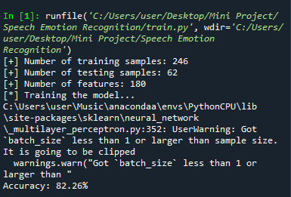
TRAINED MODEL OUTPUT and ACCURACY
Fig 2 Accuracy of the model

Slide 18
OUTPUT AND RESULT PERFORMANCE EVALUATION
Linear predictive coding (LPC) is a method used mostly in speech processing for representing the spectral envelope of digital signal of speech in compressed form, using the information of a linear predictive model.
It is one of the most powerful speech analysis techniques, and one of the most useful methods for encoding good quality speech at a low bit rate and provides highly accurate estimates of speech parameters.
LPC is the most widely used method in speech coding and speech synthesis.
Codebook is a representation of feature vector of all voice signals that have passed the clustering process.

Slide 19
OUTPUT AND RESULT PERFORMANCE EVALUATION
Comparison between MFCC and LPC in recognize same dateset with same system is given in the below figure.
Based on the above figure, it can be concluded that MFCC is better feature extraction method in this case. Whatever codebook size used, MFCC has always better accuracy.
Fig 2 The graph showing the accuracy between LPC and MFCC algorithm.

Slide 20
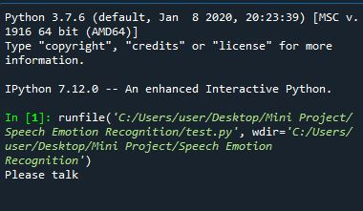
OUTPUT AND RESULT SCREENSHOTS
Fig 3 Output of the Model

Slide 21




OUTPUT AND RESULT SCREENSHOTS
Fig 4 The Emotions detected using the model

Slide 22
REFERENCES
1.Nwe, T. L., Wei, F. S., De Silva, L.C. “Speech based emotion classification”. Electrical and Electronic Technology, 2001. TENCON. Proceedings of IEEE Region 10 International Conference on, Volume: 1 , 19-22 Aug. 2001. Pages: 297 - 301 vol.1
2.Pantic, M., Rothkrantz, L.J.M. Toward “an affect-sensitive multimodal human-computer interaction”. Proceedings of the IEEE , Volume: 91 Issue: 9 , Sept. 2003. Page(s): 1370 – 1390
3.De Silva, L.C., Ng, P. C. “Bimodal emotion recognition. Automatic Face and Gesture Recognition”, 2000. Proceedings. Fourth IEEE International Conference on, 28- 30 March 2000. Pages: 332 – 335.
4.E. Kim, K. Hyun, S. Kim, Y. Kwak, “Improved Emotion Recognition with a Novel SpeakerIndependent Feature”, IEEE/ASME Transaction on Mechatronics, vol. 14, no. 3, Jun. 2009.
5.I.Bisio, A. Delfino, F. Lavagetto, M. Marchese, A. Sciarrone, “Gender-driven emotion recognition through speech signals for ambient intelligence applications”, IEEE Transaction on Emerging Topics in Computing, vol. 1, no. 2, pp. 244-257, Dec. 2013.

Slide 23

THANK YOU

